Slide 1

Joins II

Slide 2
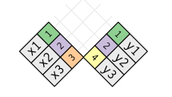
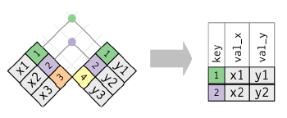
Graphical Depiction
Inner Join
Notes on Inner Join
Generally Inappropriate
Easy to Lose Observations

Slide 3
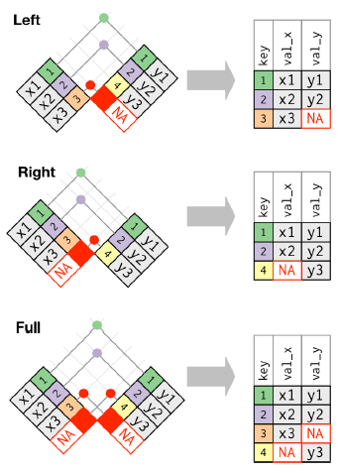
Graphical Depiction
Outer Join

Slide 4
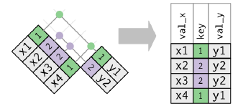
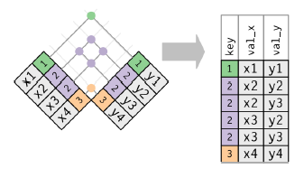
Graphical Depiction
Duplicate Keys
Using Left Join
One Table Has Duplicates
Both Tables Have Duplicates

Slide 5
Joins Assignment
Instructions
Download Analysis 2 File
Open Analysis 2 Rmd File
Knit to HTML
Read Introduction
Three Part Assignment
Part 1: Scrape GDP Data
Part 2: Scrape Additional Data
Part 3: Merge Datasets
All Data in HTML Tables

Slide 6
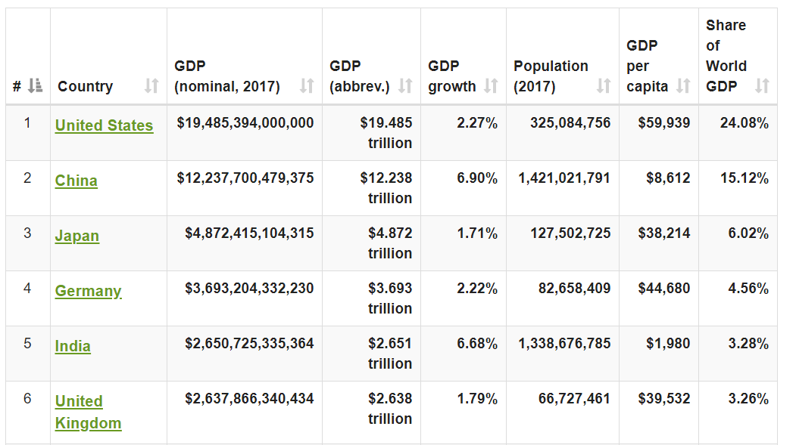
Part 1: GDP
GDP Data by Country
Webscrape Data Using rvest
Clean Data Using
str_replace()
str_replace_all()
Special Character: “$”

Slide 7
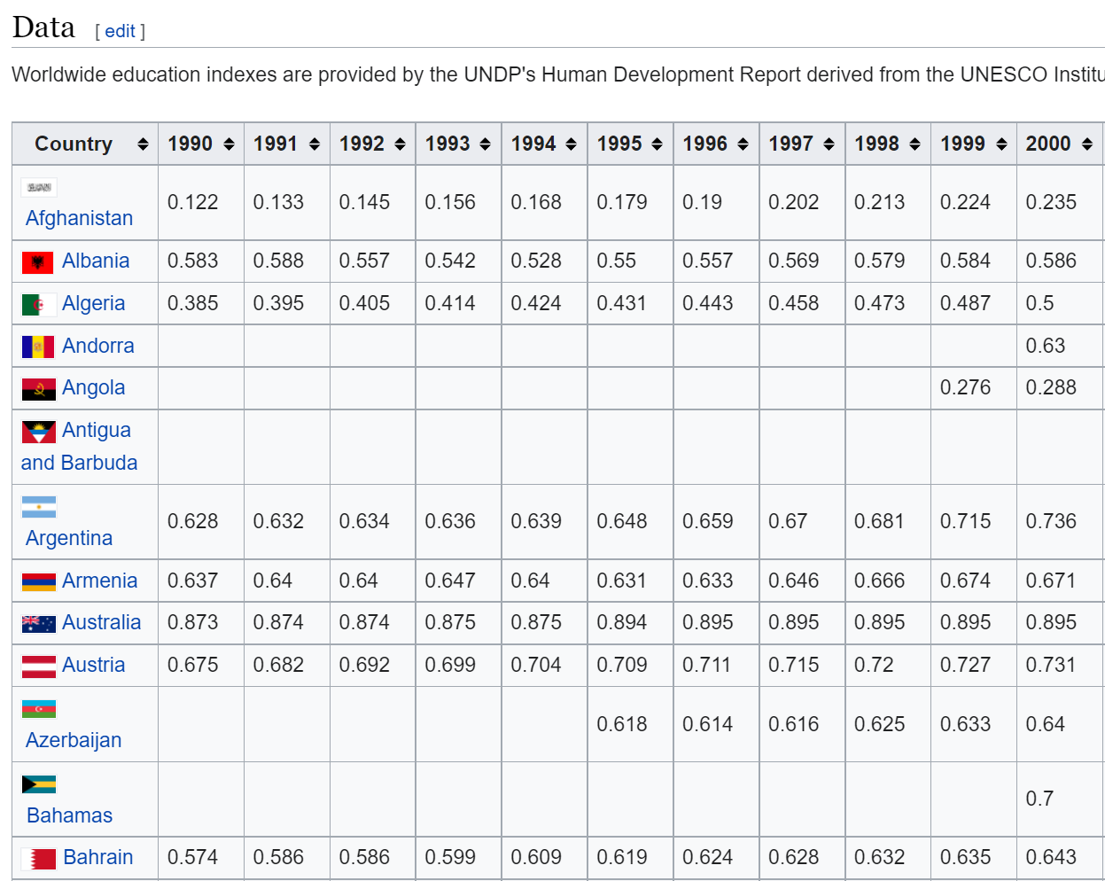
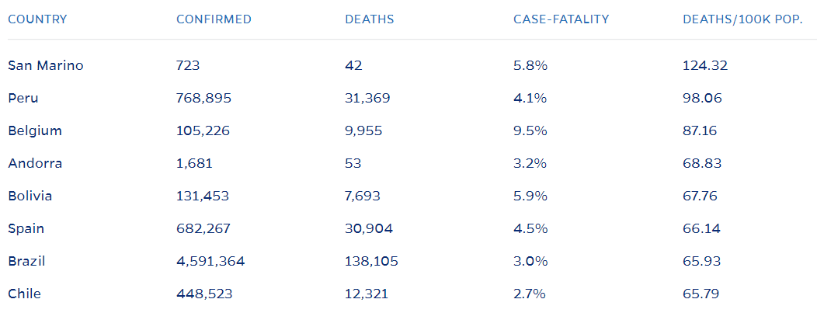
Part 2: More Data
Education Data
Coronavirus Data

Slide 8
Part 3: Merges
Two Different Merges
Education Into GDP
GDP Into COVID
Use Appropriate Join -> “Into”
Answer All Follow-Up Questions
Fix Specific Instances
> ifelse(VAR==“OLD”, “NEW”, VAR)

Slide 9
Closing
Disperse and Make Reasonable Decisions

